Slide 1

Dr. Babasaheb Ambedkar Technological University, Lonere (Dist. Raigad)
Presentation On
Face Mask Remainder System
By
Gaurav. V. Topre (10303320181137210017)
Susmita. S. Pawar (10303320181137210018)
Under the guidance of
Mr. Tejas. U. Mahagaonkar
Department of Electronics and Telecommunication Engineering

Slide 2
TABLE OF CONTENTS
01
02
03
INTRODUCTION
LITERATURE REVIEW
NEED
04
05
06
BLOCK DIAGRAM
WORKING METHEDOLOGY
COMPONENTS
Brief about this system
In records
Why do we need to design this ?
Schematic of system
How it works ??
Used while building
07
08
09
FUTURE WORK
CONCLUSION
REFERENCES

Slide 3
1. INTRODUCTION
Our human body temperature is high than all the normal objects around us so on the basis of temperature we can easily distinguished. We are using same principal to design this system the motion detector we are using here will detect the human body movement on the bases of its comparatively high body temperature and will send that signal to controller.
We can surely say that face mask is the GARMENT OF THE YEAR it sound quite weird but its true face masks and hand sanitizer are the only things which can help us to protect ourself from corona virus. Here we are designing a system which will do work of alarm for us but this alarm will not remind us of time but it will remind us about our face masks. Now a days automation is playing a vital role in each and every sector so this is small step towards automation in human behaviour of forgetting things.
Surely here the system is made for reminding us about our mask but we can surely use this for other things too by making certain changes in it.

Slide 4
2. LITERATURE REVIEW
The Novel corona virus outraged in November 2019 in Vuhan, China first case of COVID -19 was found there. Soon the virus spread throughout the world, according to reports of various well known health organization including World health organization had included face masks in their guidelines for protection from Corona virus. Recently the lockdown which was imposed everywhere was loosen and people are allowed to go to their offices and work but many surveys showed that majority of people not wearing mask and the reason they are giving for that is that they forgot their face mask. Many cities and countries had made it compulsory and started charging fines on those who failed to wear masks. Though many are fined with huge amount multiple times still they are continuously failing to carry their mask with them again the reason was same.
Some digits are shown in next slide about covid-19 Patient counts.

Slide 5
3. NEED
Corona Virus Cases
(till 26th Nov 2020)
9.27 M
Number of deaths
Total Recovered!
135 K
Recovery Rate
8.68 M
93.63%

Slide 6

Countries With maximum number of cases
Region Where face masks are mandatory
Trace of virus and mask compulsion (world)

Slide 7

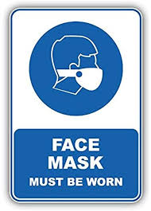
Mask were made compulsory almost all over the world…..
The data we shown in previous slide was a support to statement in which WHO and Indian Central government had made mask compulsory.
When various magazines carried out survey on why beside of these strict guidelines citizen were not wearing face mask. Results popped out after this survey were shocking one.
Let me show you those.

Slide 8
This survey proved that the main reason human behaviour, as we forget many daily use things in the same we are forgetting our face masks too. Also see the graph in which fines are shown.
So, we are designing this system as ultimate solution to this problem. Our system will remind you about your face mask every single time you step out.
Now let’s start with actual working

Slide 9
4. BLOCK DIAGRAM
Operator
Keypad
PIR SENSOR (II)
Moving
Person
🏃
PIR SENSOR (I)
ARDUINO UNO
Moving
Hand
✋
Mask
Box
Buzzer
LCD display

Slide 10
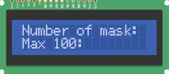
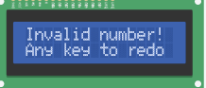

5. WORKING METHEDOLOGY
System Setup
System Initialization:-
Initialization of this system starts when operator inserts mask in the container, after inserting certain amount of mask he will enter the same amount to system using 4x4 keypad. Capacity of container is of 100 masks and the same thing will be displayed on the LCD.
In case operator enters amount which is greater than 100 then system will not accept that and will display invalid number message as shown below.

Slide 11
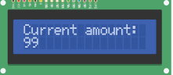
System Setup
System Initialization:-
Now once operator inserts mask and enters the same amount to the system his job is done now functioning of our system starts with displaying the available amount or current amount of masks.
Now our PIR sensor is active, till now it was not detecting motion in front of it but now it will send signal to microcontroller with every outstepping person

Slide 12
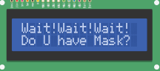
Mask remainder process
The working of this circuit is very simple. Firstly whenever a person move outside from his door his motion will be detected by PIR sensor and the respective signal will be sent to microcontroller here Arduino UNO as soon as Arduino receives signal from PIR sensor its will give two outputs first will be beep through buzzer which will help us in interrupting the outstepping person at the same time the warning message will be displayed on 16x2 LCD display fixed at front panel of system exactly where the buzzer is mounted. The display message will be “Warning!!! Do you have mask?”.

Slide 13
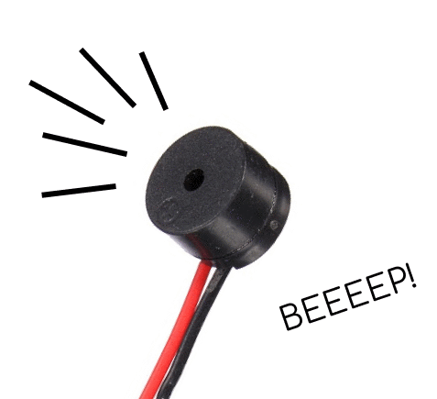
Mask remainder process
Now by this message the person will get an remainder of his face mask. Now , if he is having his face mask he can move without doing anything but if he is not having his mask then accordingly the massage will be displayed on the LCD screen that he can take one mask for him from the mask container placed near the system. Now this thing is having double benefit first is that he got to know that he had forgot his mask and second is that now for taking mask he need not to go inside he can take one from the container. The record of number of masks in the container will be maintained on display as explained in next slide.

Slide 14
Mask remainder process algorithm chart
Beep and remainder message
Having mask
YES
NO
Print Thanking message
Instruct to pick one mask from container
Decrement current amount by 1
And print advice for not forgetting mask from next time
Available masks = 2
NO
YES
STOP
Print Out of masks message

Slide 15
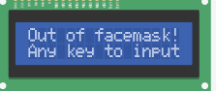
Mask count maintenance
When Box is having 1 mask left:-
When the box is having last mask left then in this situation the message that will be shown on display will be “OUT OF MASK…”, in this case if some one presses any key then the system will be reset and stop its detection and will not start detection till operator puts masks in container.

Slide 16
Mask count maintenance
How system keeps count of masks :-
As soon as operator enters amount of masks he inserted in the container our system starts working and starts its main task of detection and display. Now if person is having his mask he will move on ignoring the message displayed but if he not having one then we had instructed him to take one from container through our display messages. Now as soon as he enters his hand inside the container to pick a mask for him the second PIR sensor installed inside the mask container will detect the motion of hand will send signal and that signal will show its output on display by doing decrement in present number of masks in container. In this way after each mask pick the present amount will be decremented by one. In this way we are keeping track of number of masks available to us.

Slide 17
6. COMPONENTS
Arduino UNO
Bread Board
Multiple Jumper Wire
Programming Cable
PIR Sensor (2)
Potentiometer
220 ohm Resistor
Keypad (4*4)
Buzzer
LCD Display (16*2)

Slide 18
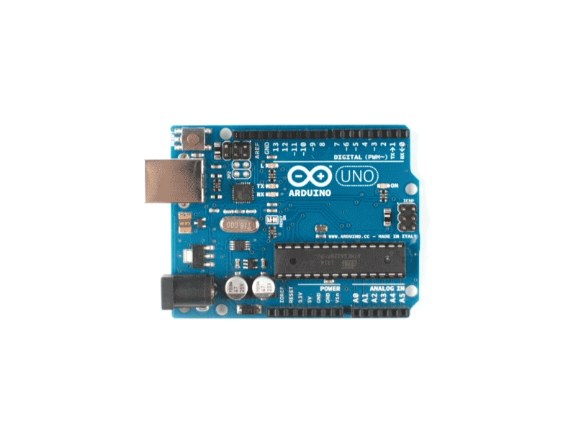
Arduino UNO
The Arduino UNO is an open-source microcontroller board based on the Microchip ATmega328P microcontroller and developed by Arduino.cc [3]. The board is equipped with set of digital and analog input/output pins that may be interfaced to various expansion boards and other circuits. The board has 14 digital I/O pins (Six capable of PWM output), 6 analog I/O pins, and is programmable with the Arduino IDE (integrated development environment), via a type B USB cable [4]. It can be powered by the USB cable or by an external 9V battery , though it accepts voltage between 7-20 V. It is similar to the Arduino Nano and Leonardo.[5][6]. The hardware reference designed is distributed under a creative commons attributions share alike 2.5 license and is available on the Arduino website.

Slide 19
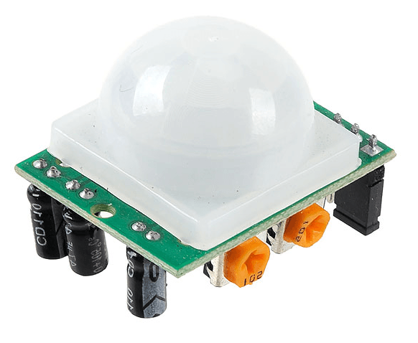
Passive Infrared Sensor
The PIR sensor is an electronic sensor that measures infrared (IR) light radiating for objects in its field of view. They are most often used in PIR based motion detectors. PIR sensor are commonly used in security alarms and automatic lightning application.
They are also called as PID “Passive Infrared Detector”
These sensors works entirely on the basis of infrared radiation detection emitted by or reflected from object
Range :- Normally 10 meters but we used range of 6-8 feet
Angle between it’s rays is: - 108.6 degree
PIR sensors can detect human only when they are in motion this is it’s limitation, whereas this limitation can be overcome by using GRID EYE sensor.
PIN 1 | VCC (5v to 12V DC )
PIN 2 | Output (motion detection signal)
PIN 3 | Ground / negative connection
Pin Connections of PIR sensor

Slide 20
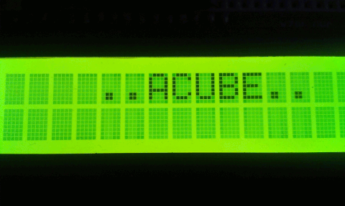
LCD Display (16x2)
An LCD is an electronic display module that uses liquid crystal to produce a visible image. The 16*2 LCD display is very basic module commonly used in circuits. The 16x2 translates a display 16 characters per line in two such lines. In this LCD character is displayed in a 5x7 pixel matrix. There are 6 pins for contrast, 8 for data and remaining 2 are called background display pins.
Pin 1 | Pin 2 | Pin 3 | Pin 4 | Pin 5 | Pin 6 | Pin 7 | Pin 8 | Pin 9 | Pin 10 | Pin 11 | Pin 12 | Pin 13 | Pin 14 | Pin 15 | Pin 16
GND | VCC | VD | RS | RW | E | D0 | D1 | D2 | D3 | D4 | D5 | D6 | D7 | 5V | GND

Slide 21
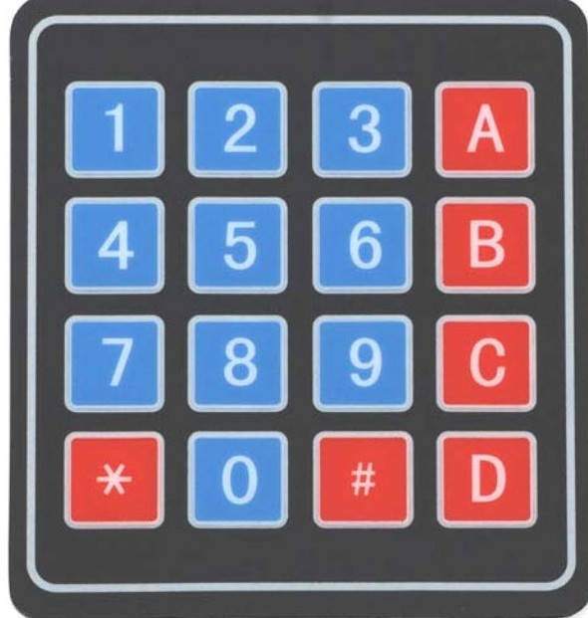
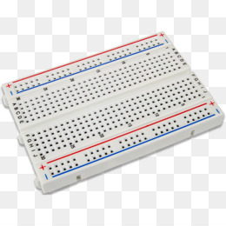
Keypad (4x4)
Keypad 4x4 is used for loading numeric values into the microcontroller. It consists of 16 buttons arranges in a form of array containing four ROWS and four COLUMNS. It is connected to the development system by regular IDC 10 female connectors plugged in some development system’s port.
Bread-board
Board which is constructed based on prototyping on electronics. Originally the word referred to a literal bread board, a polished piece of wood used for slicing bread. Breadboards are generally used for mounting components to take trial of circuits before soldering them.

Slide 22
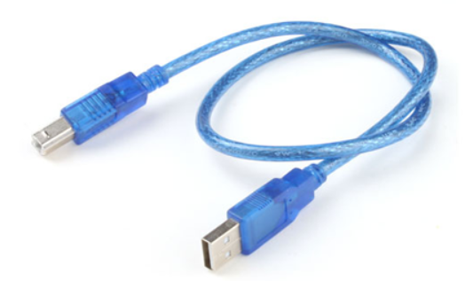
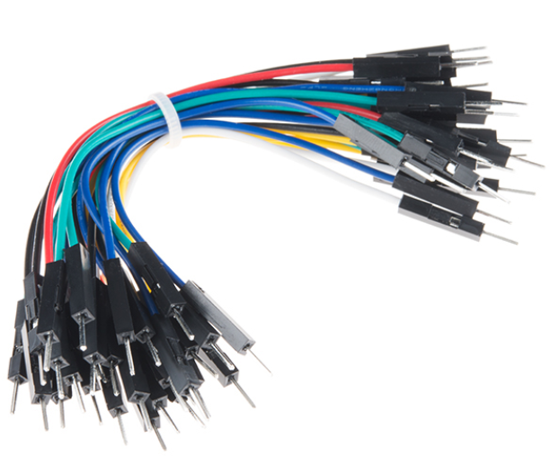
Programming Cable
One of two standard USB connectors, are the USB Type B connector(Technically known as “Standard B” connector) is roughly square in appearance with squarish protrusion on the top. Type B ports are found on many USB non-host devices, such as Arduino Uno , etc.
Jumper Wires
Jumper wire is an electrical wire, or group of them in a cable, with a connector or a pin at each end, which is normally used to interconnect the components of a breadboard or other prototype or test circuits, internally or with other equipment or components without soldering.

Slide 23
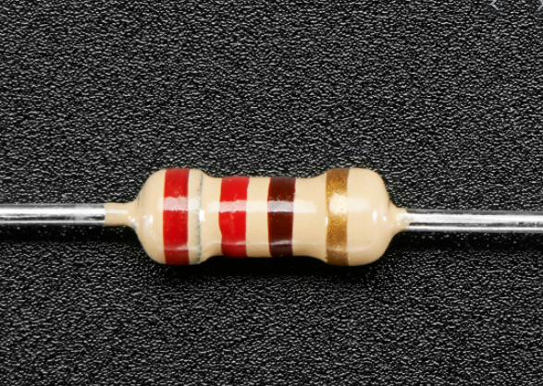
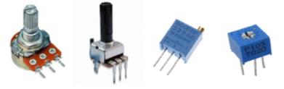
Resistor 220 ohm
A resistor is passive two terminal electrical component that implements electrical resistance as a circuit element. In electrical circuit, resistors are used to limit circuit current flow to adjust signal levels, bias active elements, and terminate transmission lines among other uses. The colour code for 220ohm resistor is as shown in the figure.
Potentiometer
Potentiometer is noting but the variable resistor with the third adjustable terminal. The potential at the third terminal can be adjusted to give any fraction of the potential across the end of resistor.
We used SINGLE TURN pot here.

Slide 24
7. FUTURE SCOPE
The current design we are having is made for face mask remainder but we can surely make a design an prototype for sanitizer remainder which will remind every entering person to sanitize his hands and things he is carrying.
01
Student –staff attendance
Hand Sanitizers
Sanitize hands before entering.
It’s a gas giant and the biggest planet
03
02
Vaccine Count
To count number of people getting vaccinated

Slide 25
CONCLUSION
The main issue that many of the people are getting fined as shown in survey they will not get finned and the most important thing this system will help citizens in keeping their face masks with them. We human being having natural tendency of forgetting things of our daily use now mask being one of them. So this system is smart solution to our human tendency.
The system we designed is with simple PIR sensor and it is in budget so that it can be installed at every office and housing society.

Slide 26
REFERENCES
“Programming Arduino getting started with sketches”, by Simon monk.
Tinkercad user manual for learning basics of simulation software with Arduino support.
“Intro to Arduino”, Princeton.edu. Archived from original pdf 3 April 2018.
Design advice and assembly instruction from a motion detector kit.
“Arduino Cookbook”, O’reilly publication.
“Arduino: Advance methods and strategies of using Arduino”, by Ethan Thorpe.
Ministry of health and family welfare Bulletin (dated 25th Nov 2020) for count of corona patients.
World health Organization report (October 2020) for precautionary measures against COVID-19.

Slide 27
THANK YOU ! We open house for questions….

